Slide 1
Empresas Contratantes
PAULISTA LAJEADO
Entidades Executoras
Projeto PD-00642-2705/2019 Usinas Hidrelétricas Reversíveis Combinadas com Hidrelétricas em Cascata e seus Benefícios para a Gestão do Setor Elétrico Brasileiro
Apresentação 20/04/2020
Usinas Hidrelétricas Reversíveis: Relato de Visita a Operadores Regionais, Agencia Regulatória e Depto. de Energia dos EUA em Fev./2020
Prof. Paulo Barbosa

Slide 2
Apresentação 20/04/2020
Usinas Hidrelétricas Reversíveis: Relato de Visita a Operadores Regionais, Agencia Regulatória e Depto. de Energia dos EUA em Fev./2020
Objetivo da Viagem e Visitas
Conhecer o papel das UHRs nos Sistemas de Potencia dos EUA
Saber como as UHRs são operadas / despachadas no grid
Conhecer a base regulatória da UHRs nos EUA
Saber tendências atuais de novos investimentos /expansão
Conhecer as formas de remuneração das UHRs

Slide 3
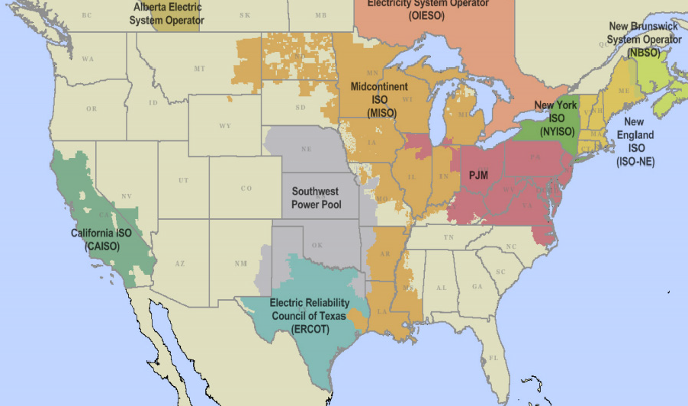
Operadores Regionais de Sistemas e Mercados dos EUA
Realizam Operação de Mercado (=CCEE) e Operação de Sistemas Regionais (=ONS)
Respondem por cerca de 2/3 do consumo dos EUA (total = 4000 TWh anuais)
Operam mercados competitivos de atacado, com Preços Horários, locacionais (por barra)
O Preço é formado de forma competitiva, por ofertas de geração e compra, nos mercados
Day-Ahead, Intra-day.
Há também Mercado de Capacidade e de Serviços Ancilares
Selecionados

Slide 4
Operadores Regionais de Sistemas e Mercados dos EUA Selecionados
Capacidade: 31.000 MW, Receita Anual: U$ 9,6 bilhoes (2018)
6 estados do NE dos USA : Connecticut, Maine,
Massachusetts, New Hampshire, Rhode Island, and Vermont.
https://www.iso-ne.com/
Capacidade: 180.000 MW, Receita Anual: U$ 50 bilhoes
13 estados dos USA : Pensilvania, New Jersey, Mariland e outros.
https://www.pjm.com/
Capacidade: 175.000 MW, Receita Anual: U$ 29 bilhoes
15 estados dos USA e 1 província do Canadá (Manitoba)
Midcontinent Independent System Operator
https://www.misoenergy.org/
Entidade Regulatória:
Energy Department (DOE):
https://www.energy.gov/

Slide 5
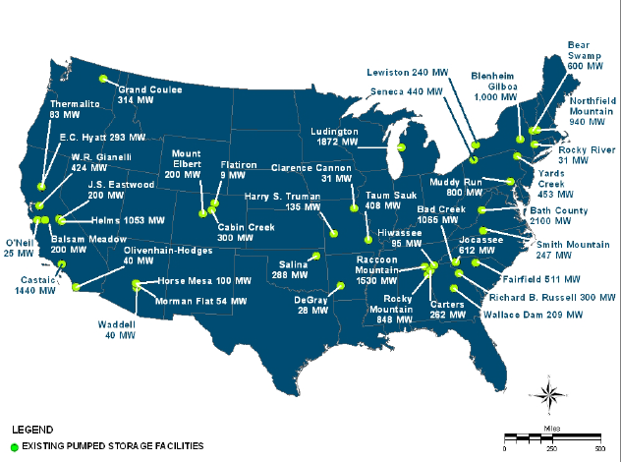
Plantas Construídas – Status de 1995
New England ISO
MISO
PJM

Slide 6
Capacidade: 31.000 MW, Receita Anual: U$ 6 bilhoes
6 estados do NE dos USA : Connecticut, Maine,
Massachusetts, New Hampshire, Rhode Island, and Vermont.
Receita Anual: U$ 6 bilhoes ( 6,0 de Energy Markets e 3,6 de Capacity Markets)
Desde a década de 70: Pumped Storage é a forma predominante de storage
Duas grandes plantas são capazes de suprir 1.800 MW em 10 min,
No máximo, podem prover até 12.000 MWh de energia
Receita Anual: U$ 6 bilhoes ( 6,0 de Energy Markets e 3,6 de Capacity Markets)
Regras de Participação no Mercado Despachável:
Podem participar do Mercado de energia, capacidade, reserva e regulação, como
Fonte despachável de suprimento ou de carga
Importância no Grid: Fonte de confiabilidade para o grid, despachável com muita
agilidade (Northfield: 940 MW em 6 min)

Slide 7
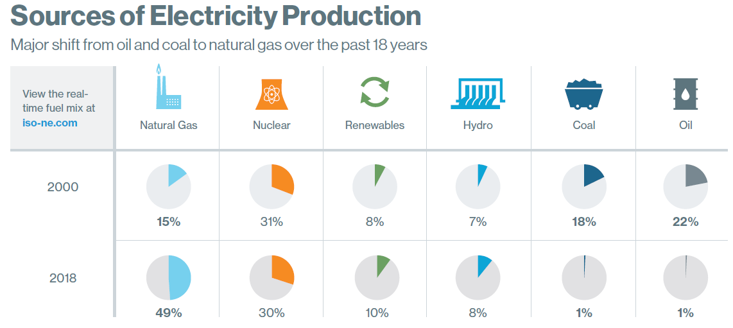
Importância Futura: Transição para Renováveis
Expansion Plans (2027):
Wind Power: from 1,4 GW to 13,5GW
Solar: from 2,8 to 5,8 GW

Slide 8
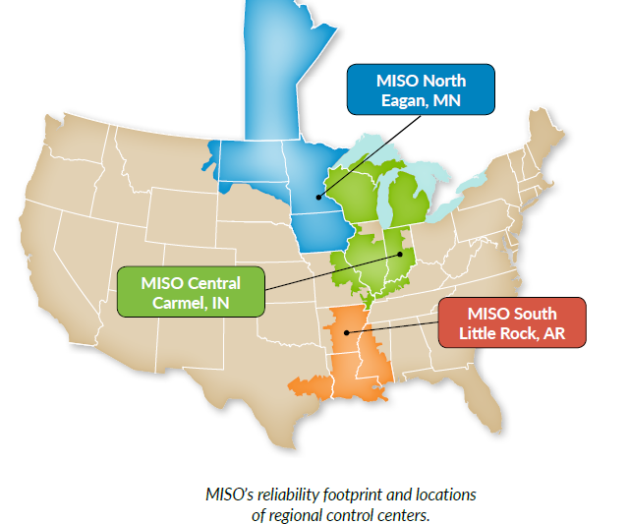
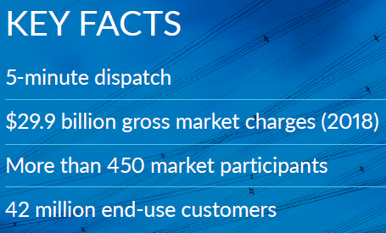
Capacidade: 175.000 MW, Receita Anual: U$ 29 bilhoes
15 estados dos USA e 1 província do Canadá (Manitoba)

Slide 9
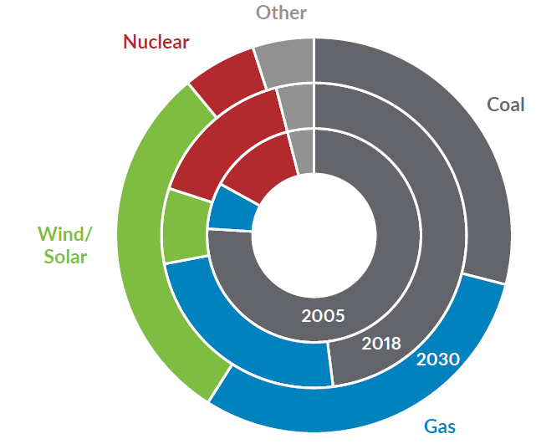
Capacidade: 175.000 MW, Receita Anual: U$ 29 bilhoes
15 estados dos USA e 1 província do Canadá (Manitoba)
Evolução da Matriz – Capacidade Instalada :

Slide 10
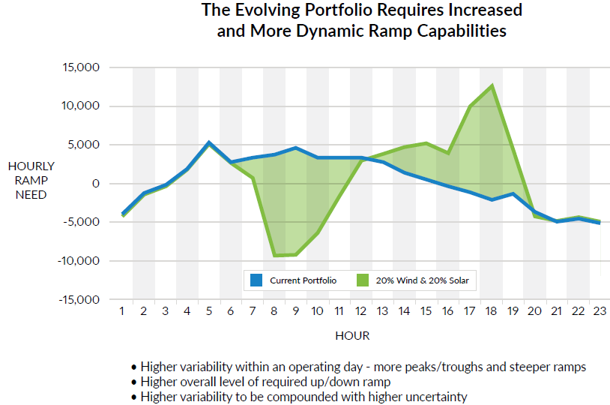
Transição Energética:
Mais Necessidades de Rampa, Reservas e Flexibilidade Operacional

Slide 11
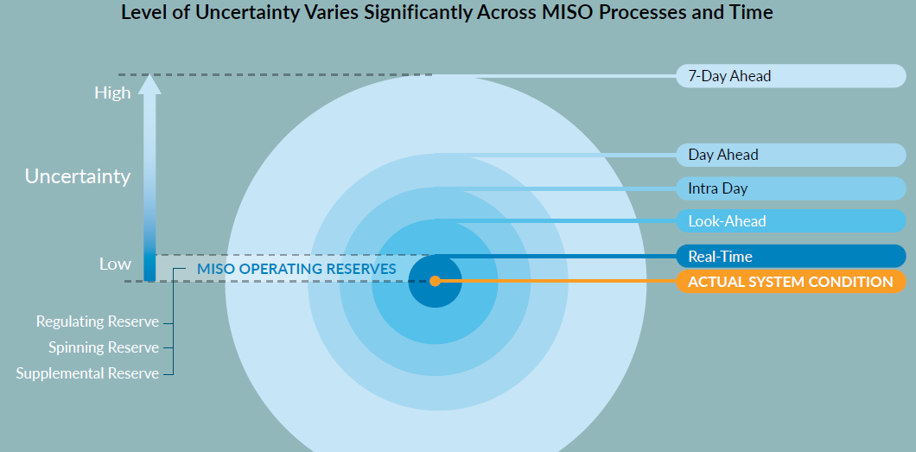
Transição Energética:
Mais Necessidades de Rampa, Reservas e Flexibilidade Operacional

Slide 12
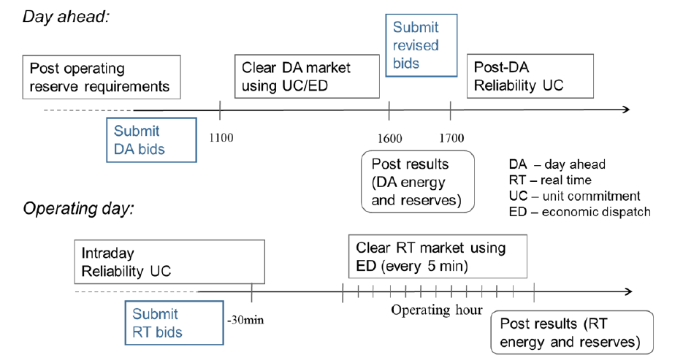
Organização dos Mercados no MISO

Slide 13
Usinas Hidrelétricas Reversíveis no MISO- Questões e Respostas
Ciclo de Operação:
Mostly daily cycle
2. Eficiência das Plantas
The round trip efficiency is about 80%
3. Funções das UHRs no MISO
PSHs currently arbitrage on energy price difference between night and daytime peaks.
They can also provide regulating reserve, contingency reserves and flexible ramp product on generating mode.
The fast ramping capability benefit real time ramping and ancillary service needs.
4. Are there specific MISO rules or procedures to dispatch PHS plants? For example, notification times required from MISO or from PHS owners?
We allow PSH to submit startup and notification time for DA and RT unit commitment (similar to other generators).

Slide 14
Usinas Hidrelétricas Reversíveis no MISO- Questões e Respostas
5. Is there a plant priority dispatching rule? how is the position of the PHS plants on this priority sequence?
There is no priority dispatching rule. All resources are dispatched based on offers to the market through security constrained unit commitment and economic dispatch.
In capacity market, energy limited resources are required to have at least 4-h continuously available energy during emergency.
They can be dispatched to emergency limits during emergency.
6. The storage of PHS plants can be computed as a part of the Installed Reserve Margin (IRM) of MISO?
There is 4-h continuous availability requirement for capacity accreditation purpose.

Slide 15
Usinas Hidrelétricas Reversíveis no MISO- Questões e Respostas
7. How PHS plants are ranked in terms of their flexibility attributes for MISO power system operation, compared to other fast generators sources (ex. Natural Gas plants)?
PSH definitely can provide great flexibility. We don’t have very much other hydro plants. Overall PSH is a small percentage in the market. We can’t count on PSHs only. Other resources such as gas are also needed.
8. Please, can we have access to reports, MISO operating manuals and other publications about PHS plants?
Here is the link to MISO BPM. We usually try to develop rules for all resource types. So rules specific to PHS may be limited.
https://www.misoenergy.org/legal/business-practice-manuals/

Slide 16
Usinas Hidrelétricas Reversíveis no MISO- Questões e Respostas
9. In which MISO markets Pumped Hydro Storage -PHS plants have regular participation? Day-ahead, intra-day, ancillary services?
Capacity market, Day ahead and real time markets.
Also forward reliability assessment commitment (FRAC), intraday RAC and 3-h look ahead commitment.
10) Where are the main sources of revenue for PHS plants?
It should be energy.

Slide 17
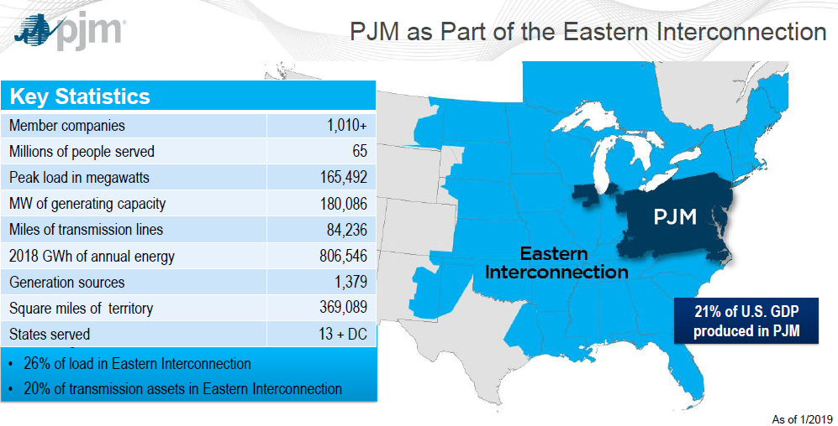
Capacidade: 180.000 MW, Receita Anual: U$ 50 bilhoes
13 estados dos USA : Pensilvania, New Jersey, Mariland e outros.

Slide 18
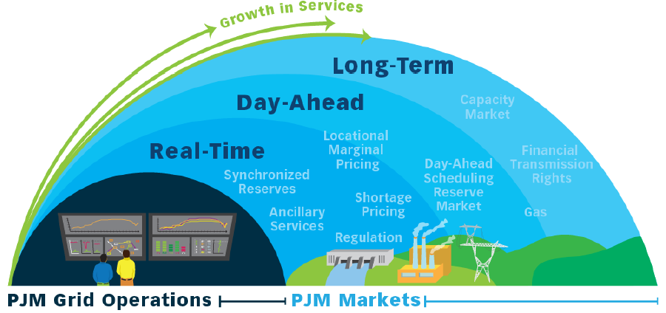
Organização das Funções e Mercados do PJM

Slide 19
Recursos de Storage no PJM
Pumped Hydro Storage: 5000 MW
Thermal (water heaters): 90 MW
Flywheel: 20 MW
Batteries 300 MW
(around 150 MW connected to the transmission grid, dispateched by PJM operator)

Slide 20
Questions and Answers from PJM
Contributions of PHS in the PJM
Fast response to mitigate intermittence is very useful for the grid operator.
PHS are as fast and flexible as gas thermal and hydro. They are not prioritized for dispatch. Dispatch is controlled by market (cost merit).
2. Are there specific PJM rules or procedures to dispatch PHS plants? For example, notification times required from PJM or from PHS owners?
In general, there are no specific rules. Dispatch is fully controlled by market. Notification is required in advance for unusual operation in large units.
3. Which is the contribution of PHS plants during outages of other plants or transmission lines? Is there a plant priority dispatching rule?
The role of PHS during outages is similar to other fast-response and black-star capable sources.

Slide 21
Questions and Answers from PJM
4. The storage of PHS plants can be computed as a part of the Installed Reserve Margin (IRM) of PJM ? If yes, full or minimum storage (how much?) of PHS has to be available during peak hours of the Summer or Winter?
PHS can be part of both synchronized and non-synchronized reserves. Non-synchronized units are able to come online within 10 minutes.
5. In which PJM markets Pumped Hydro Storage -PHS plants have regular participation? Day-ahead, intra-day, ancillary services?
They have regular participation in day-ahead, intra-day and ancillary services.
6. Where are the main sources of revenues for PHS plants?
Did not have accurate information, but would send it to us. Arbitrage is a source of revenue, but capacity market and ancillary services are the main ones.

Slide 22
Fontes de Receitas dos Geradores no PJM – Ano de 2018
Obs. 1- As UHRs (indicador relativo: 1.23) foram superiores a Carvão (0.81), Térmica a Oil (0.67) e Termicas a Gás CC (1.0) e foram inferiores a UHE convencional (2,23) e Nuclear(3,5) em termos de receita líquida anual
Obs. 2- As receitas das UHRs em 2018 vem do mercado de energia e serviços ancilares ( 49%) e do mercado de capacidade (51%)

